Slide 1
Professional Issues in Information Technology
Computer Contracts
Dr Aftab Maroof
Spring 2021
National University of Computer & Emerging Sciences-FAST, Islamabad Campus

Slide 2
Computer Contracts
What is Agreement?
Every promise / set of promises forming the consideration for each other is an agreement. Not bound by the law.
What is Contract?
A contract is simply an agreement between two or more persons (the parties to the contract) that can be enforced in a court of law.
The parties involved may be legal persons or natural persons.
Promise or set of promises, the performance of which the law will recognize as a duty and for the breach of which the law provides a remedy.
There is no specific form for a contract. What is essential is:
All the parties must intend to make a contract.
All the parties must be competent to make a contract.
There must be a ‘consideration’, that is, each party must be receiving something and/or providing something.

Slide 3
Computer Contracts
Questions regarding Contract?
Is there a contract?
What are its terms?
Is the contract enforceable by the court?
Has there been a breach of the contract?
What damages do you award?
Elements of a Contract?
Offer:
Expression of a present intention to create a binding agreement.
Acceptance:
Agreement with offer by any manner reasonable under the circumstances; must mirror the offer.
Consideration:
Generally, courts will only enforce a contract if both sides are getting something.
What each side gives the other is called consideration.
Legal “detriment” to both sides that is the reason for the agreement.
Notes:
In the law of contracts, the mirror image rule, also referred to as an unequivocal and absolute acceptance requirement, states that an offer must be accepted exactly with no modifications. The offeror is the master of one's own offer. An attempt to accept the offer on different terms instead creates a counter-offer, and this constitutes a rejection of the original offer
To incur detriment means to cement a promise by either refraining from doing something that one has a legal right to do or by doing something that one is not under any legal obligation to do
Legal Detriment: The promise- will lose something in order to gain some other things he desires

Slide 4
Computer Contracts
Terms of the Contract?
Common Law:
Agreement between the parties must supply the details sufficient to allow enforcement.
Determine terms to which parties agreed
Terms implied by law
Warranties
Express warranties (promise, commitment, undertaking, agreement)
Disclaimer of warranties (A disclaimer is generally any statement intended to specify or delimit the scope of rights and obligations that may be exercised and enforced by parties in a legally recognized relationship)
Notes:
Warrantee :guarantee, assurance, promise, commitment, covenant, undertaking, agreement

Slide 5
Computer Contracts
Computer Contracts:
Computer contracts present special problems due to unique nature of computer technology
Intangible Property
Intellectual Property Rights / Laws
Failure of Systems - not meeting customer requirements
Failure of Systems - not coping with organizational growth
Threat?
Damages claimed by the customer
A mistake in the choice of equipment or software coupled with a poor contract can be disastrous for a purchasing company.
The company making the acquisition will need to decide:
How the contract can protect it if the equipment or software fails to perform as it should?
How it should be maintained and how its staff should be trained?
What to do if the software or hardware infringes a third party’s copyright or patent?

Slide 6
Computer Contracts
Computer Contracts (Contd.):
Sample Case:
Ministry of Information vs. Faujisoft (2001)
Rs 1.1 million project
MIS, 4-modules (Personnel, Inventory, Accounts, News Archiving)
No formal requirements / specifications were provided by the Ministry
Faujisoft itself studied and proposed a system
Contract was developed by Faujisoft and the same got approved without consultation of the Ministry of Law
Faujisoft got money in advance (initial stages)
Rs 0.550 million bank guarantee was there (6-months validity)
Oracle 8 was purchased (licensed) from Ora-Tech, 2 DBA’s trained
Software delivered was full of bugs, not meeting user requirements and thus could not get implemented
As per contract / terms & conditions, nothing could be claimed
Poor Contract -> how much loss of public money?

Slide 7
Computer Contracts
Computer Contracts (Contd.):
Contract Assessment:
What if the software contains bugs?
What if the computer / software goes down in the middle of the wages run?
What if the client copies the programs and distributes the copies?
What if the program run too slowly to be of any practical use?
What if the computer becomes obsolete and the manufacturer washes his hands of it?

Slide 8
Computer Contracts
Computer Contracts (Contd.):
General Terms and Conditions of a Contract:
Scope / Requirements Specification
Contract Management
Price
Payment Conditions
Delivery and Acceptance
Intellectual Property Rights
Information, Facilities and Materials to be Provided by the Client
Conditions relating to Staff
Change Control

Slide 9
Computer Contracts
Computer Contracts (Contd.):
General Terms and Conditions of a Contract:
Warranty
Liability for Loss or Damage
Confidentiality
Indemnity (security or protection against a loss or other financial burden)
Termination
Force Majeure (unforeseeable circumstances that prevent someone from fulfilling a contract)
Notices
Arbitration (dispute resolution)
Applicable Law

Slide 10
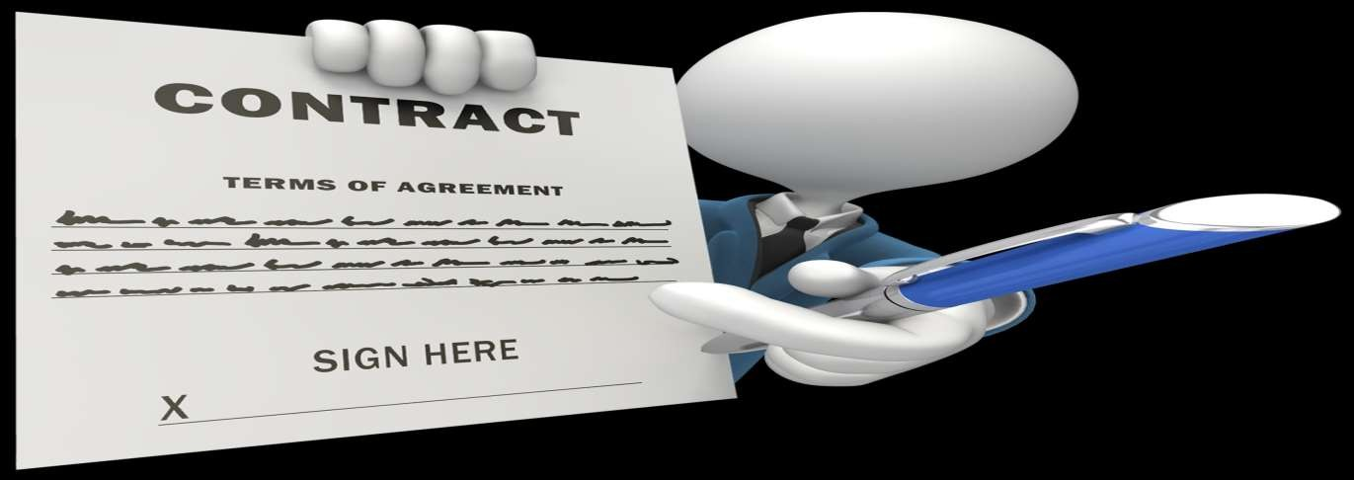
Software Contracts

Slide 11
Software Contracts
Contracts set out the agreement between the parties
They set out the aims of the parties provide for matters arising while the contract is running ways of terminating the contract and the consequences of termination
Contracts Provide Legal Securities to Project and Parties, i.e. Customer or Software Developers
There are gaps in the agreement because the parties have failed to
contemplate a particular issue
There are almost never disputes over contracts which run perfectly But, if things go wrong?? For Example Marriage.

Slide 12
Structure of the Contract: The introductory Section
The first part of the contract is brief; it states that it is an agreement between the parties whose names and registered addresses are given.
It often begins with a set of definitions of terms used in the course of the agreement
For example, the definitions section will tell us that Company X Ltd, the software house, is to be referred to throughout the contract as “The Company”, and Company Y Ltd, which has commissioned the work, is to be known throughout as “The Client”.

Slide 13
Structure of the Contract: The Clause section
1. What is to be produced?
It is clearly necessary that the contract states what is to be produced.
Refers to a separate document which constitutes the requirements specification.
Software engineers will be familiar with the problems of producing requirements
A specification sets out the detailed requirements of the client. Ideally, the
Specification should be complete, consistent and accurate and set out all that the client
Wants to be done in the performance of the contract

Slide 14
Structure of the Contract: The Clause section
2. What is to be delivered?
Producing software for a client is not, usually, a matter of simply handing over the text of a program which does what is required.
The following is a non-exhaustive list of possibilities:
source code;
command files for building the executable code from the source and for installing it;
documentation of the design and of the code;
reference manuals, training manuals and operations manuals;
software tools to help maintain the code;
user training;
training for the client’s maintenance staff;
test data and test results.

Slide 15
Structure of the Contract: The Clause section
3. Ownership of rights
It is important that the contract should also state just what legal rights are being passed the software house to the client under the contract. Ownership in physical items such as books, documents or discs will usually pass from the software house to the client, but other intangible rights, known as intellectual property rights.
It is important for the contract to state precisely who is to own these rights. Do they pass to the client or are they retained by the software house?

Slide 16
Structure of the Contract: The Clause section
4. Confidentiality
A second area of intellectual property law which should be considered in a software contract is confidentiality. The commissioning client may well have to pass confidential information about its business operations to the software house.On the other side of the coin, the software house may not want the client to divulge to others details of the program content or other information gleaned about its operations by the client.

Slide 17
Structure of the Contract: The Clause section
5. Obligations of the client
In almost all cases where work is being carried out for a specific client, the client will have to fulfil certain obligations if the contract is to be completed successfully. The following is a (non-exhaustive) list of possibilities:
provide documentation on aspects of the client’s activities or the environment in which the system will run;
provide access to appropriate members of staff;
provide machine facilities for development and testing;
provide accommodation, telephone and secretarial facilities for the company’s staff
when working on the client’s premises;
provide data communications facilities to the site.

Slide 18
Structure of the Contract: The Clause section
6. Standards and methods of working
The supplier is likely to have company standards, methods of working, quality assurance procedures, etc. and will normally prefer to use these. More sophisticated clients will have their own procedures and may require that these be adhered to.
In some cases, the supplier may be required to allow the client to apply quality control procedures to the project. The contract must specify which is to apply.

Slide 19
Structure of the Contract: The Clause section
7. Project Managers
Each party needs to know who, of the other party’s staff, has day-to- day responsibility for the work and what the limits of that person’s authority are. The standard terms and conditions should therefore require each party to nominate, in writing, a Project Manager.
The Project Managers must have at least the authority necessary to fulfil the obligations which the contract places on them. It is particularly important that the limits of their financial authority are explicitly stated, i.e. the extent to which they can authorize changes to the cost of the contract.

Slide 20
Structure of the Contract: The Clause section
8. Acceptance procedure
Acceptance procedures are a critical part of contract for they provide the criteria by which successful completion of the contract is judged.
The essence of the acceptance procedure is that the client should provide a fixed set of acceptance tests and expected results and that successful performance of these tests shall constitute acceptance of the system.

Slide 21
Structure of the Contract: The Clause section
9. Indemnity
It could happen that, as a result of the client’s instructions, the supplier is led unwittingly to infringe the intellectual property rights of a third party or that, through carelessness or dishonesty, the supplier provides a system which infringes such rights—perhaps through using proprietary software as a component of the system delivered. For this reason, it is advisable to include a clause under which each party indemnifies the other for liability arising from its own faults in this respect.

Slide 22
Structure of the Contract: The Clause section
10. Termination of the contract
There are many reasons why it may become necessary to terminate a contract before it has been completed.
for example, for the client to be taken over by another company which already has a system of the type being developed, or for a change in policy on the part of the client to mean that the system is no longer relevant to its needs
the contract make provision for terminating the work in an amicable manner

Slide 23
Structure of the Contract: The Clause section
11. Arbitration
If the event of a dispute that cannot be resolved by the parties themselves, they agree to accept the decision of an independent arbitrator.

Slide 24
Structure of the Contract: The Clause section
12. Inflation
In lengthy projects or projects where there is a commitment to long term maintenance, the supplier will wish to ensure protection against the effects of unpredictable inflation.
To handle this problem, it is customary to include a clause which allows charges to be increased in accordance with the rise in costs.

Slide 25
Structure of the Contract: The Clause section
13. Applicable law
Where the supplier and the client have their registered offices in different legal jurisdictions or performance of the contract involves more than one jurisdiction, it is necessary to state under which laws the contract is to be interpreted.

Slide 26
Structure of the Contract: The Authority section
The authorities of both party signature on the term and conditions mentioned in the clause section.
The most Important things are Starting and ending date of an Agreement.
Only an Authorized person from each party is mentioned in this Section.

